Slide 1
Asphalt Binder Changes in Indiana
June 2024

Slide 2
Introduction
This presentation has been developed by the Asphalt Pavement Association of Indiana (APAI) to help provide background and express the impact of the new liquid asphalt binder changes across Indiana.
If there are questions regarding information in this presentation, please contact:
Elizabeth Pastuszka, Director of Technical Services with APAI
epastuszka@asphaltindiana.org
317.586.7280

Slide 3
Outline
Introduction
Asphalt Mixtures
PG Binder Changes in Indiana
APAI’s Local Guidance Resources

Slide 4
Asphalt Mixtures

Slide 5

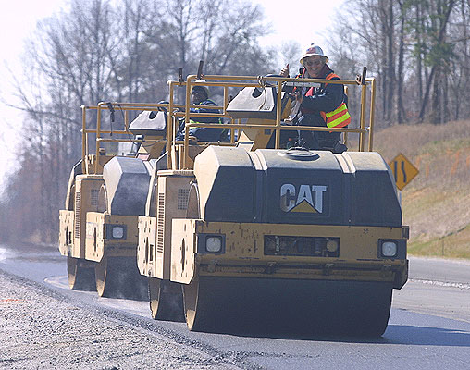

Asphalt Pavements are…
100% recyclable
Smooth and Quiet
Cost Effective
Quickly Constructed
Durable and Versatile

Slide 6
Recent Changes in asphalt pavement…
INDOT implementation of SP5 to increase in-place density by 1.5%
Partnering for PG binder specification changes with INDOT, APAI, Asphalt Mixture Producers, Asphalt Binder Refiners and Suppliers
Collaboration with INDOT Pavement Design to improve subgrade strength through trials on I-69 north of Pendleton.
Changes to INDOT pay factors to emphasize the effective asphalt content and capture the in-place specific gravity of the asphalt mixture.

Slide 7
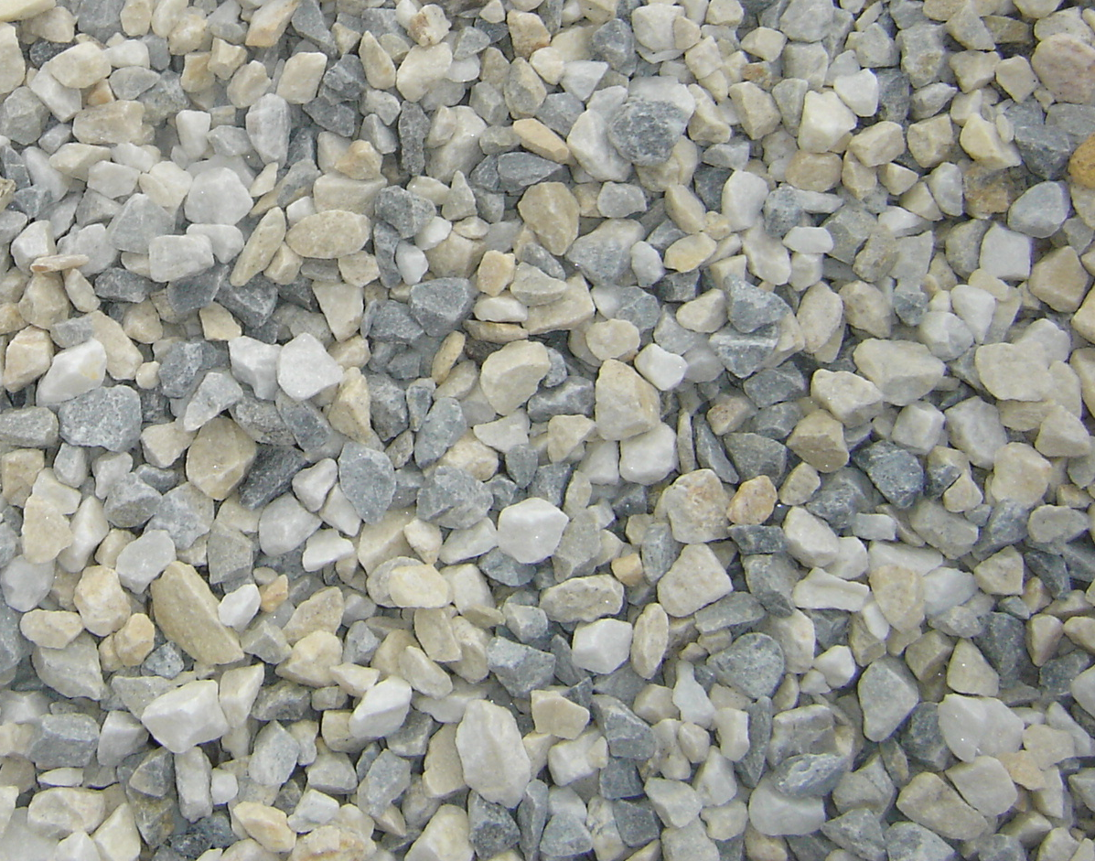
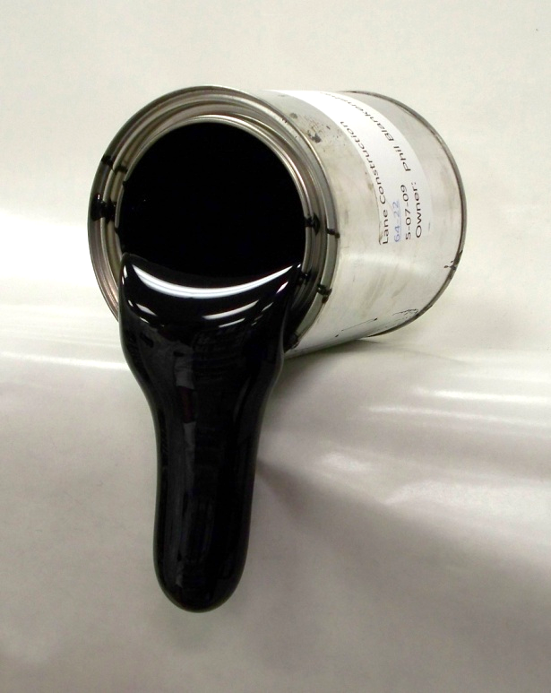

What is Asphalt?
Asphalt Mixtures are made of three components:
0% by Mass, 3-7% by Volume
Air
Liquid Asphalt Binder
4-6% by Mass, 11-12% by Volume
Aggregates
94-96% by Mass, 83-84% by Volume

Slide 8
Liquid Asphalt Binder
Asphalt Mixtures are made of three components:
0% by Mass, 3-7% by Volume
Air
Liquid Asphalt Binder
4-6% by Mass, 11-12% by Volume
Aggregates
94-96% by Mass, 83-84% by Volume

Slide 9
Asphalt Binder
Gasoline
Kerosine
Light Gas Oil
Heavy Gas Oil
Asphalt
Asphalt is a black, viscoelastic material.
“viscous” meaning the material will flow when force is applied for a length of time
“elastic” meaning the material will partially return to its original shape after the force is removed
At elevated temperatures, asphalt hardens to provide internal cohesion to the mixture and adhere to aggregate particles. Asphalt binder is the “glue” that binds aggregate particles together in an asphalt mixture providing cohesion and structural integrity.

Slide 10
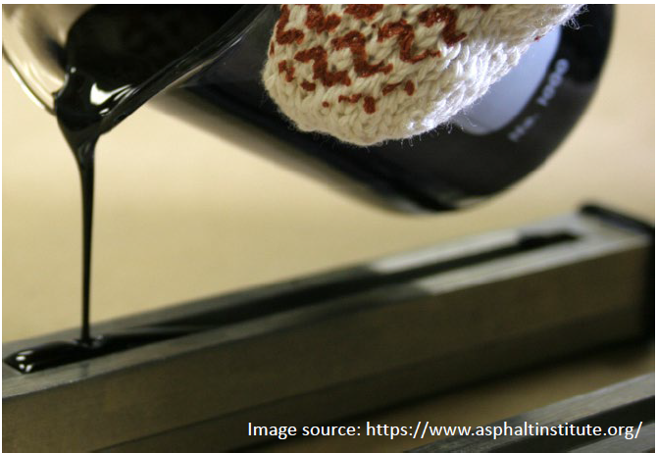
Asphalt Binder
Asphalt Behavior is dependent on:
Temperature
Time of Loading
Aging

Slide 11
Asphalt Binder Nomenclature
147°F
-7°F
PG 64-22
Performance Grade
High Temperature ◦C
highest 7-day average pavement temperature
Low Temperature ◦C
lowest historical yearly pavement temperature
The HIGHER the high-grade temperature, the stiffer, more rut resistant the asphalt binder
The LOWER the low-grade temperature, the softer, more crack resistant the asphalt binder

Slide 12
Asphalt Binder Changes in Indiana

Slide 13
Why were these changes made?
INDOT’s Executive Staff met with APAI for suggestions to improve the asphalt pavement performance
Outside Consultant was hired and made recommendations
Task force met several times to determine an implementation strategy and specification changes
  Asphalt Mix Producer Executive Staff, Estimators, Project Managers, QC
  Asphalt Binder Refiners, Suppliers, and Technical Liaisons
  DOT Materials, Design, Asset Management, and Construction

Slide 14
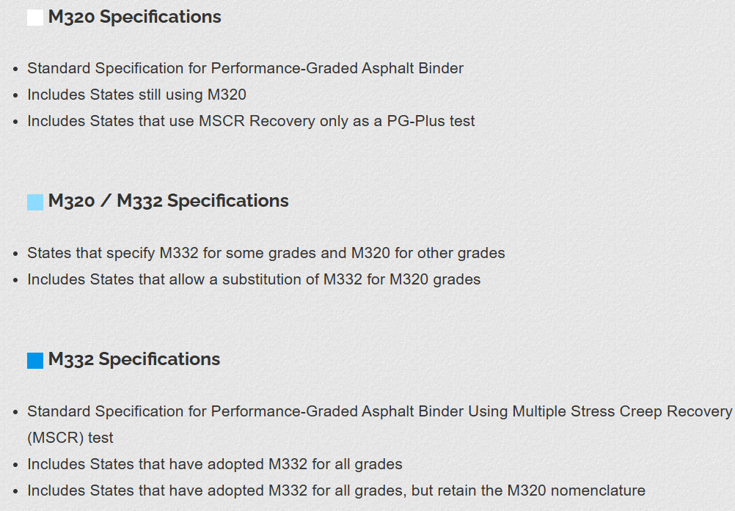
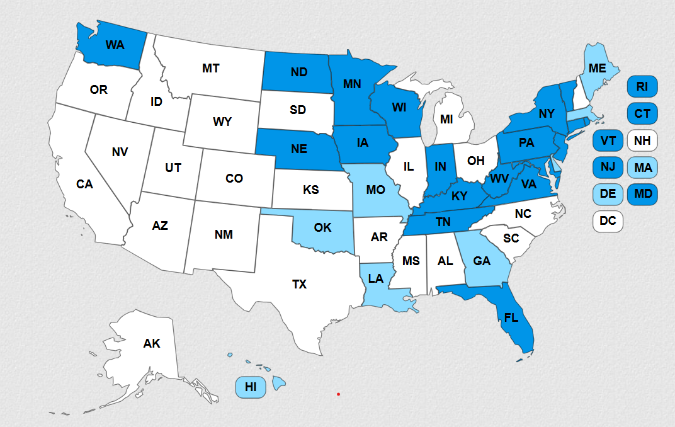
https://www.asphaltinstitute.org/engineering/specification-databases/us-state-binder-specifications/

Slide 15
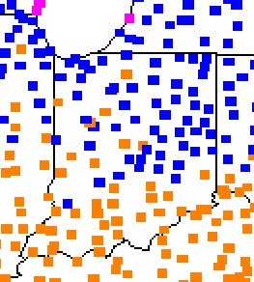
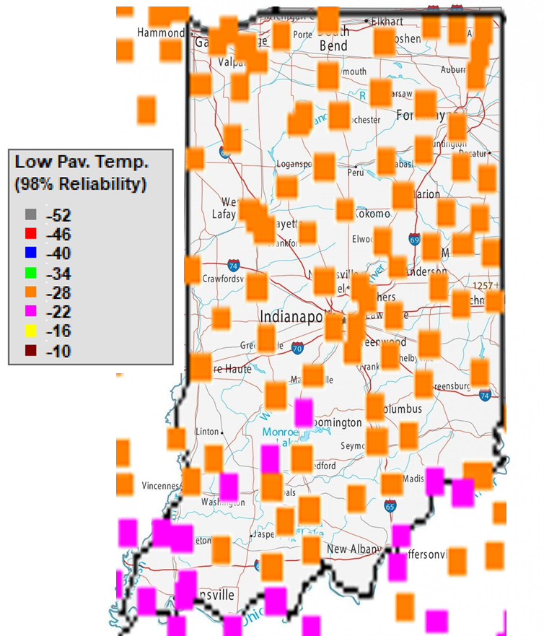
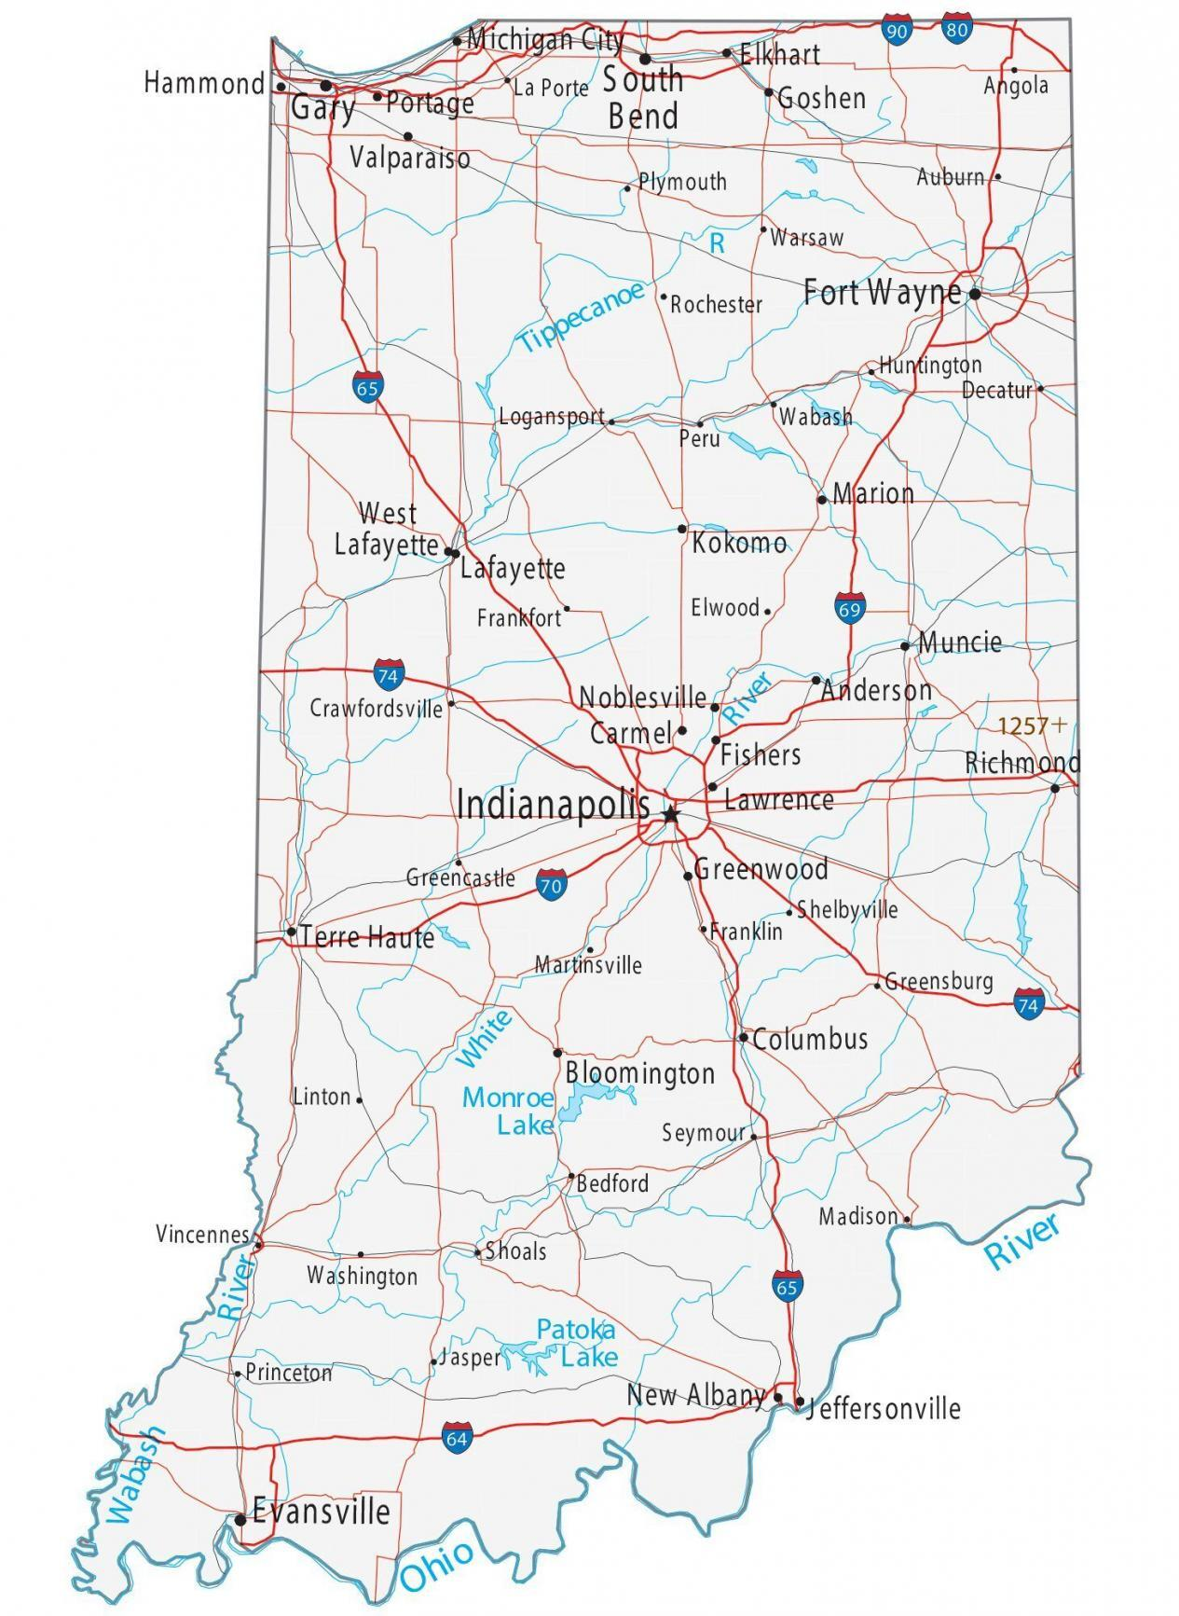
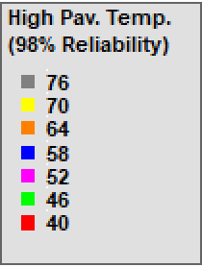
Materials
High Temperature
Low Temperature

Slide 16
Asphalt Binder
Performance graded testing (AASHTO M320)
  Developed as part of the SHRP for Superpave mix design research to find tests for binders that better relate to field performance testing in 1987.
  Measures physical properties in terms of rutting, fatigue cracking and low temperature cracking
  Tested at the binder’s high temperature.
  Puts an oscillatory load on the material at relatively low shear strain which doesn’t accurately represent the ability of some polymer modified binders to resist rutting. Under these low levels of stress and strain, the polymer network is not activated.
  Shortcoming for polymer modified asphalt (PMA) and limitations of the PG system to characterize PMA. Many agencies adopted tests to verify the presence of polymer and/or guarantee a minimum elastic response provide by polymer modifications. “PG-plus” test for elastic recovery, forced ductility, toughness and tenacity and phase angle tests.

Slide 17
Asphalt Binder
MSCR graded testing (AASHTO M 332) with Elastic Response (AASHTO R92)
  Multiple Stress Creek Recovery (MSCR) is the latest improvement to Superpave PG binder specifications. Higher levels of stress and strain are applied to the binder, better representing what occurs in the pavement. With these higher levels, the response of the asphalt binder shows the stiffening effects of the polymer and the elastic effects.
  Tested at the binder’s high temperature for non-recoverable creep-compliance (Jnr) and percent recovery indicating elastic behavior during each loading cycle.
  Elastic Response is the asphalt’s ability to recover its original shape after loading, or the elastic component at a given temperature and stress level. A high elastic response indicates high elastic component at the test temperature.

Slide 18
Materials
Grade Bumping
Current asphalt binder PG based on testing at different high temperatures: 64°C, 70 °C, or 76 °C.
MSR traffic levels are accounted for by increasing the stiffness (reducing the compliance) for the asphalt binder at the grade temperature, 58 °C.

Slide 19
Materials
asphalt binder nomenclature
147°F
-7°F
136°F
-18°F
PG 64-22
PG 58S-28
Performance Grade
High Temperature ◦C
highest 7-day average pavement temperature
MSCR Traffic Designation
“S” = Standard
“H” = Heavy
“E” = Extremely Heavy
Low Temperature ◦C
lowest historical yearly pavement temperature
PG high temperature grade is based on climate, but due to heavy traffic, you would bump up the high grade for stiffer binder.
MSCR binders are stiffer with traffic designation change, not high temperature.

Slide 20
Asphalt Binder “Bumping”
PG testing and nomenclature
Current asphalt binder base grade PG 64-22
One binder “bump” PG 70-22
Two binder “bump” PG 76-22
MSCR testing and nomenclature
New asphalt binder base grade PG 58-28
Traffic levels designated by letters
Neat binder PG 58S-28
One binder “bump” PG 58H-28
Two binder “bump” PG 58E-28
Current PG Binder | New PG Binder | Traffic Designation
PG 64-22 | PG 58S-28 | S – Standard
PG 70-22 | PG 58H-28 | H – Heavy
PG 76-22 | PG 58E-28 | E – Extremely Heavy

Slide 21
Asphalt Binder Changes in Indiana
Why?
  To improve the durability and quality of asphalt pavements in Indiana
What?
  All asphalt base binders will change from PG 64-22 to PG 58-28
  All asphalt binder testing will change to MSCR AASHTO M332 with elastic response requirements per AASHTO R92
When?
  INDOT contracts let on or after 9/1/2024 per RSP 400-R-780
  Contractors will have a chance to opt-in earlier with Construction Memo No. 24-08

Slide 22
Asphalt Binder Changes in Indiana
What to expect:
  Difference in cost per ton. Will be different for binder grades and binder sources.
  Storage issues at the asphalt plants if local specifications do not coincide with the DOT changes.
  Early number indicated highest cost difference between 70-22 and 58H-28
  Suppliers are starting formulations so numbers could vary now and continue to change as these grades become more common

Slide 23
Asphalt Binder Changes in Indiana
What to expect:
  New terminology for all asphalt binder material and mixture pay items. This will be reflected on:
    Contractor truck tickets and test results.
    Asphalt Binder Type A certifications from material refineries and terminals.
    Pay items for asphalt mixtures for pavement, patching, widening, tack coats, sealing or filling cracks and joints.
  Liquid Asphalt Binder Suppliers, INDOT Materials and Tests laboratory, and the Asphalt Institute performed a round robin of the new asphalt binders in 2024. Report forthcoming.

Slide 24
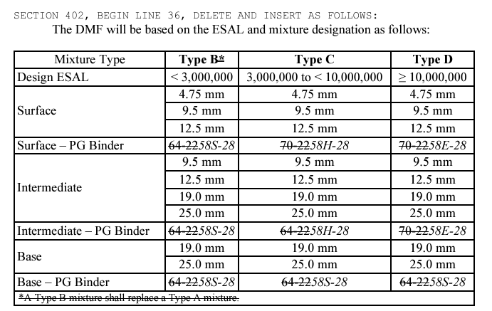
INDOT Contract Pay Item Changes
  QC/QA, HMA, (ESAL), 58 (traffic), (Course), (Mix) mm
      ESAL 2, 3, or 4
      Traffic S, H, or E
      Course Surface, Intermediate, or Base
      Mixture designation
All asphalt binder references in specifications should show PG 58-28 with MSCR traffic level designation

Slide 25
INDOT Contract Pay Item Changes
  QC/QA, HMA, (ESAL), 58 (traffic), (Course), (Mix) mm
      ESAL 2, 3, or 4
      Traffic S, H, or E
      Course Surface, Intermediate, or Base
      Mixture designation
All asphalt binder references in specifications should show PG 58-28 with MSCR traffic level designation

Slide 26
What is Asphalt?
Asphalt Mixtures are made of three components:
0% by Mass, 3-7% by Volume
Air
Liquid Asphalt Binder
4-6% by Mass, 11-12% by Volume
Aggregates
94-96% by Mass, 83-84% by Volume

Slide 27
Materials
Aggregate use and type dependent on traffic level
Angularity
Texture
Shape

Slide 28
Aggregates
Consensus Properties
Coarse Aggregate Angularity
Fine Aggregate Angularity
Flat and Elongated
Clay Content
Source Properties
Toughness
Soundness
Deleterious
Absorption
Specific Gravity

Slide 29
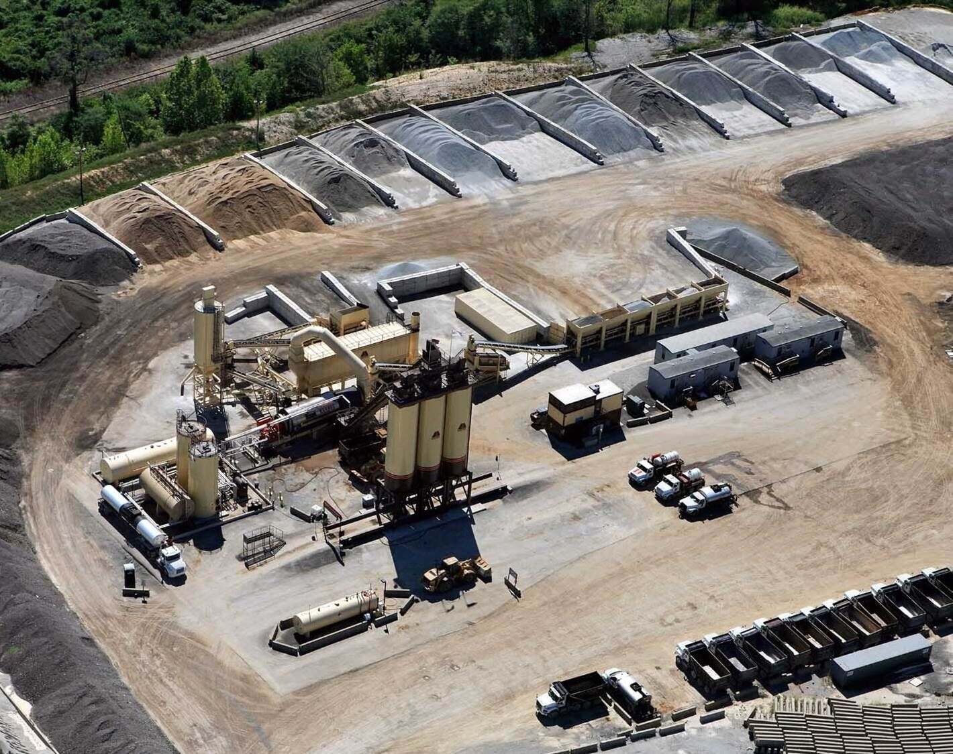
Aggregates
Use is driven by specification requirements
Size of mixture required
Look at local source availability and quality
  Can the quarry produce necessary materials?
  Will there be enough aggregates for the project?
Gradation requirements
Plant capabilities
  Number of aggregates in mix design need to be equal to or less than number of bins

Slide 30
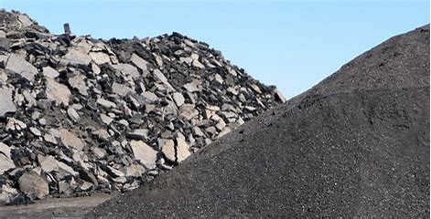
Recycled Materials
Asphalt Pavement is 100% Recyclable!
Reclaimed Asphalt Pavement (RAP)
  Produced from existing pavement
  Contains aggregates and asphalt binder
  Set aside and treated like an aggregate at the plant
Reclaimed Asphalt Shingles (RAS)
  High percent of asphalt binder but very stiff (PG 142 or higher)
  Limited on use because of stiffness
Other Recycled materials used in asphalt mixes may include ground tire rubber, fibers, glass, plastics, bio-oils
When using recycled products, the mix design should be engineered to meet quality and durability in addition to specification requirements.

Slide 31
Recycled Materials - Nationally
“the performance of pavements containing up to 30% RAP is similar to that of pavements constructed from virgin materials with no RAP.” (Copeland, 2011)
When RAP is added responsibly, performance of mixtures containing RAP can be equivalent to virgin mixtures

Slide 32

Recycled Materials - Nationally
89.2 million tons of RAP are used annually in new asphalt pavement construction in the U.S.
94% of RAP is used in new asphalt mixtures while a small percent is used in aggregate bases.
The national average is 21.1% in new asphalt mixtures.
The net reduction in GHG emissions from using RAP in new mixtures from 2009 to 2019 was estimated 21.2 million tonne CO2e, equivalent to the annual emissions of approximately 460,000 passenger vehicles!
Asphalt Pavements can help project owners earn credits under the LEED rating system
Source: NAPA publication RAP Benefits for Pavement Owners

Slide 33
Recycled Materials
$3.3 Billion are saved every year by using RAP
If an asphalt mix contains 21.1% RAP, the average cost savings is $7.80/ton of mix (NAPA, 2020)
This savings translates to 12.5% more lane-miles of paving when virgin mix can cost $70/ton.
With a $1,000,000 budget, 2.6 additional lane-miles can be paved at 1.5” deep
Increasing RAP in new mixtures by 1% would reduce emissions (CO2e) equivalent to 30,000 passenger vehicles (U.S. EPA, 2018)

Slide 34
Recycled Materials – INDOT specifications
Recycled materials may be used as a substitute for a portion of the new materials required to produce asphalt mixtures.
May consist of RAP or RAS or blend of both. RAS is not allowed in SMA mixtures.
RAP shall be processed so that 100% will pass the 2” sieve and RAP coarse aggregate shall pass the maximum size sieve for the mixture being produced.
RAS may be obtained from either pre-consumer or post-consumer asphalt shingles. Two RAS types cannot be blended.
The recycled percentages shall be specified on the DMF.
INDOT allows a maximum of 25.0% binder replacement in all HMA mixtures. RAS shall be ≤ 3.0% by total mass and ≤ 15.0% binder replacement. If a pay item is designated as PG 58S-28 and a surface mixture, the binder grade used shall be PG 58H-28 when the Binder Replacement is less than or equal to 15.0%.

Slide 35
APAI’s Resources

Slide 36
Liquid Asphalt Binder Changes
Liquid Asphalt Binder Changes One-Pager
Liquid Asphalt Binder Changes Carrying Card
Liquid Asphalt Binder Changes PowerPoint Presentation
INDOT Links
  Recurring Special Provisions with new binder verbiage
  Design Memo No. 23-21
  Construction Memo No. 24-08
WE DO LUNCH AND LEARNS/WORKSHOPS!!

Slide 37
Local Guidance Documents
Documents on APAI’s website:
  Asphalt Pavement Guidance Specification for Local Agencies
  Bid From Template
  Sample Advertisements for Bids
  Sample Award Document
  Contract Template
Checklists on APAI’s website:
  Design Mix Formula
  Field Inspector Checklist
  Plant and Lab Visit Checklist

Slide 38
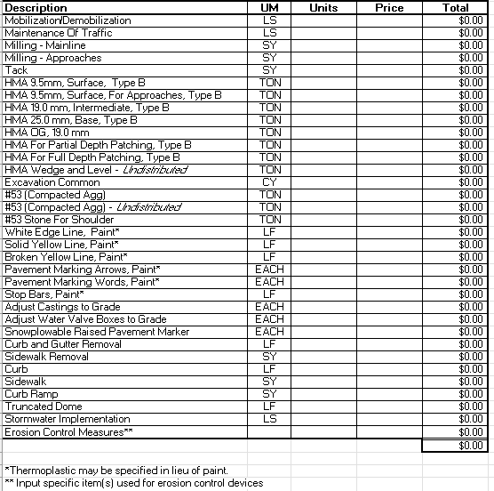
APAI Local Guidance Resources
Bid Form Template for Local Governments and Non-Governmental Asphalt Paving Applications
Excel File with list of asphalt paving and materials related to asphalt pavements

Slide 39
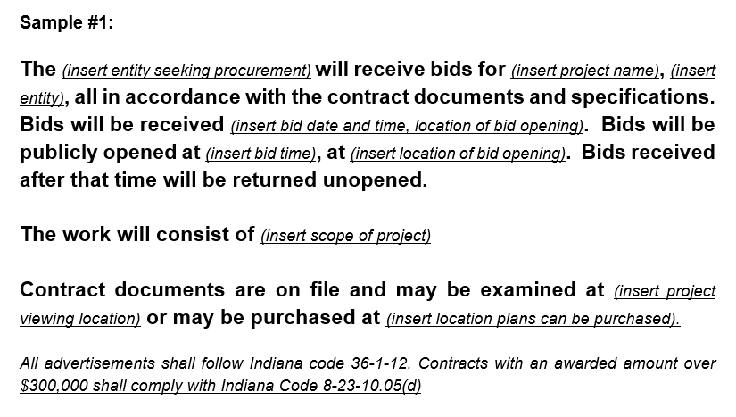
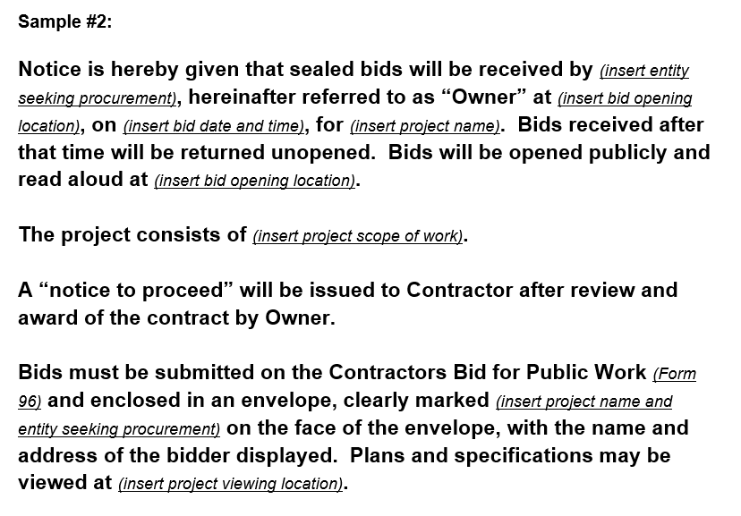
APAI Local Guidance Resources
Sample Advertisement for Bids
Two examples, editable for specific project

Slide 40
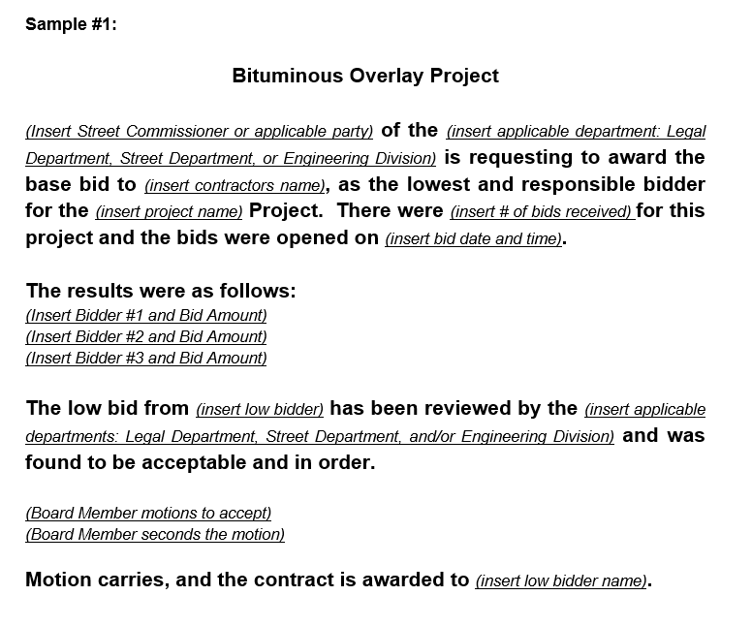
APAI Local Guidance Resources
Sample Award Document
Award documentation example completely editable for a specific project

Slide 41
APAI Local Guidance Resources
Contract Template
Sample agreement with guidance language between owner and Contractor that is editable for a specific project and outlines articles for:
Work
The Project
Contract Price
Payment Procedures
Contract Documents
Employee Eligibility Verification
Safety

Slide 42
APAI Local Guidance Resources
Asphalt Pavement Guidance Specification for Local Agencies
Outlines Design and Construction Guidance as well as local specification recommendations.

Slide 43
Guidance Specification for Local Governments
Design Guidance and Construction Guidance
Mixture Size Designation | Minimum Lift Thickness, in. | Maximum Lift Thickness, in. | Target HMA Layer Thickness, in.
9.5 mm | 1.0 | 2.5 | 1.5 or 2.0
12.5 mm | 1.5 | 3.75 | 2.5 – 3.0
19.0 mm | 2.0 | 5.0 | 2.5 – 4.0
25.0 mm | 3.0 | 7.5 | 4.5 – 6.0
Design Guidance
  Conversions
  Lift Thicknesses
  Materials
  Mixture criteria for given traffic conditions, includes PG 58-28 and new binder terminology
Mixture Type |  | Type B | Type C
Design ESAL |  | <3,000,000 | ≥3,000,000
AADT (Average Annual Daily Traffic) |  | <15,000 | 15,000 - 30,000
AADTT (Average Annual Daily Truck Traffic)* |  | <1700 | ≥1700
Surface** | Mixture Size Designation | 9.5 mm 12.5 mm | 9.5 mm 12.5 mm
 | Recommended PG Binder | 58S-28 | 58H-28
Intermediate | Mixture Size Designation | 12.5 mm 19.0 mm | 12.5 mm 19.0 mm
 | Recommended PG Binder | 58S-28 | 58H-28
Base | Mixture Size Designation | 19.0 mm 25.0 mm | 19.0 mm 25.0 mm
 | Recommended PG Binder | 58S-28 | 58S-28
Note: If a pay item is designated as a PG 58S-28 and a surface mixture has less than or equal to 15.0% binder replacement, the binder grade shall be 58H-28.

Slide 44
Design Best Practices
Align with Indiana Design Guide for lift thicknesses
Mix design follows INDOT Standard Specification section 401.05 requirements
If follow APAI guidance, mix design will come from INDOT qualified mis design laboratory and produced from an INDOT certified plant.
Mixture designations correlate to ESALs and INDOT Standard Specifications section 402
Recycled maximum in INDOT specification 25% binder replacement

Slide 45
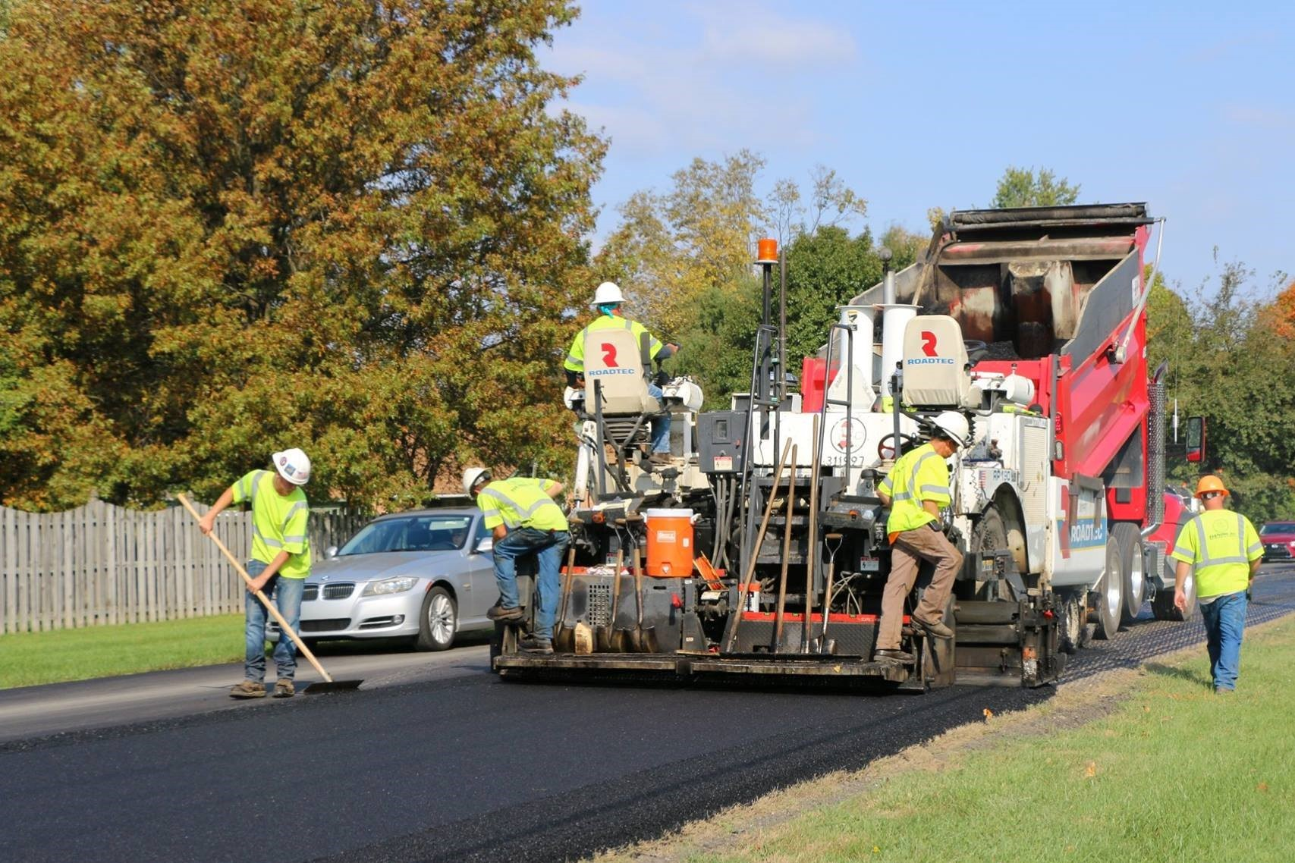
Guidance Specification for Local Governments
Design Guidance and Construction Guidance
Construction Guidance
  Subgrade, Subbase, Milling and Surface Preparation
  Tack Coat
  Asphalt Mixture Placement
  Compaction
  Weather Limitations
  Asphalt Mixture Acceptance

Slide 46
Asphalt Overlay Surface Preparation
Surface Preparation for an asphalt overlay may include one or more of the following:
Patching
Cleaning and sealing cracks
Placing a wedge or leveling course
Milling
Failed areas must be repaired and brought to good structural condition before overlaying.

Slide 47
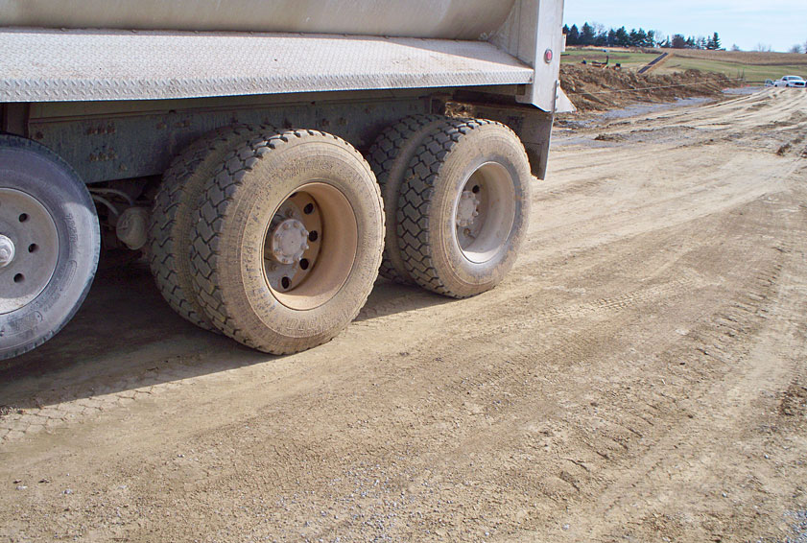
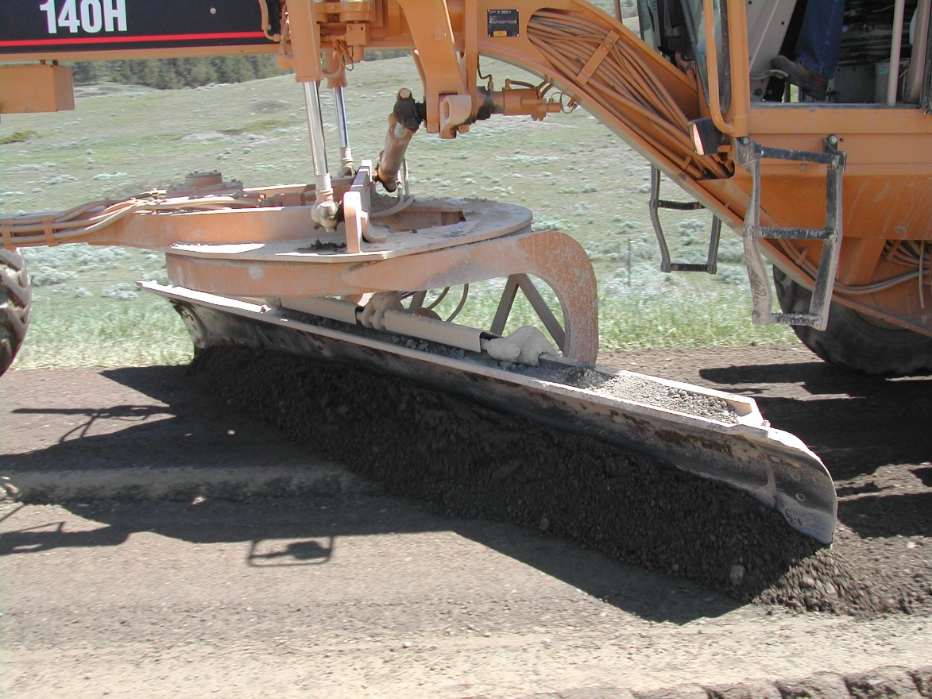
Construction Best Practices
Subgrade and Subbase
Subgrade is pavement foundation
Subgrade uniformly compacted
  Proof roll for stability or soft spots
Properly graded for drainage
  Transverse and longitudinal grade
  Smoothness and cross slope
Aggregate subbase properly compacted to percentage or proctor specified

Slide 48
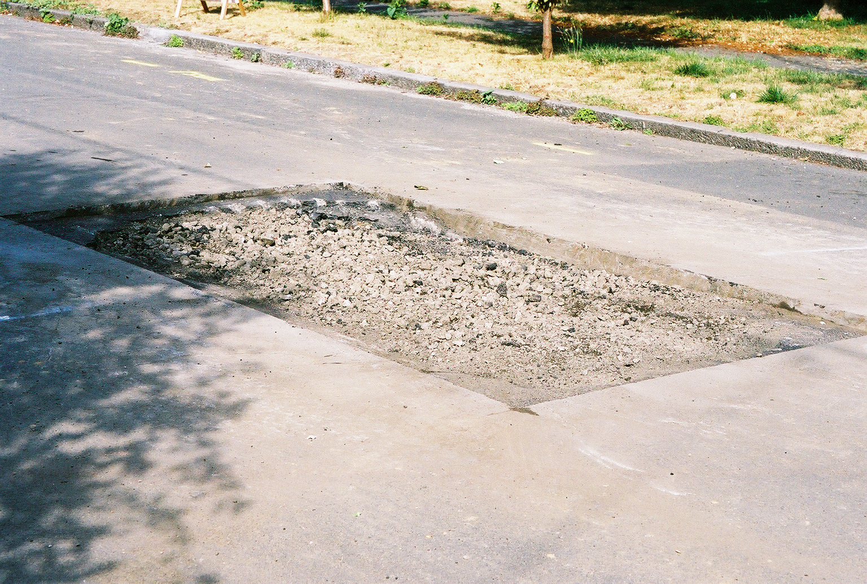
Construction Best Practices
Patching
Remove the material to be repaired until firm support is reached.
Excavation should extend at least 1-foot into the good pavement.
Clean the vertical faces and apply a tack coat.
For deep patches, apply a tack coat at the bottom of the horizontal face.

Slide 49
Construction Best Practices
Patching
Fill the patch with asphalt mixture of the same type specified.
Compact the patch thoroughly, flush with the surrounding pavement.
  Use vibrating plate for small patches or roller for large patches
  Compact corners
Make sure patches have straight lines with no distresses outside of the patch.
Check with a straightedge to make sure the patch is even.

Slide 50
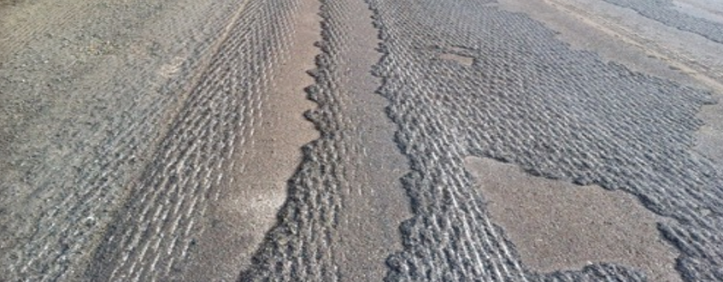
Construction Best Practices
Milling
Remove distressed pavement (rutting, top-down cracking)
Opportunity to improve cross slope
Creates RAP
Provides texturized surface for overlay
Don’t leave “scabs” of asphalt and avoid milling too deep

Slide 51
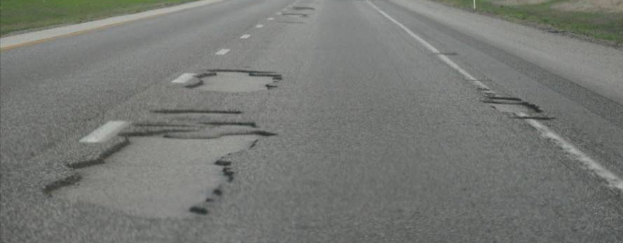
Construction Best Practices
Tack Coat
Free of foreign debris
No standing water on pavement
Apply uniformly across lane width
No streaking or ponding
Minimum 95% coverage
Sufficient time to break and set to minimize tracking
Correct areas of inadequate or excessive coverage

Slide 52
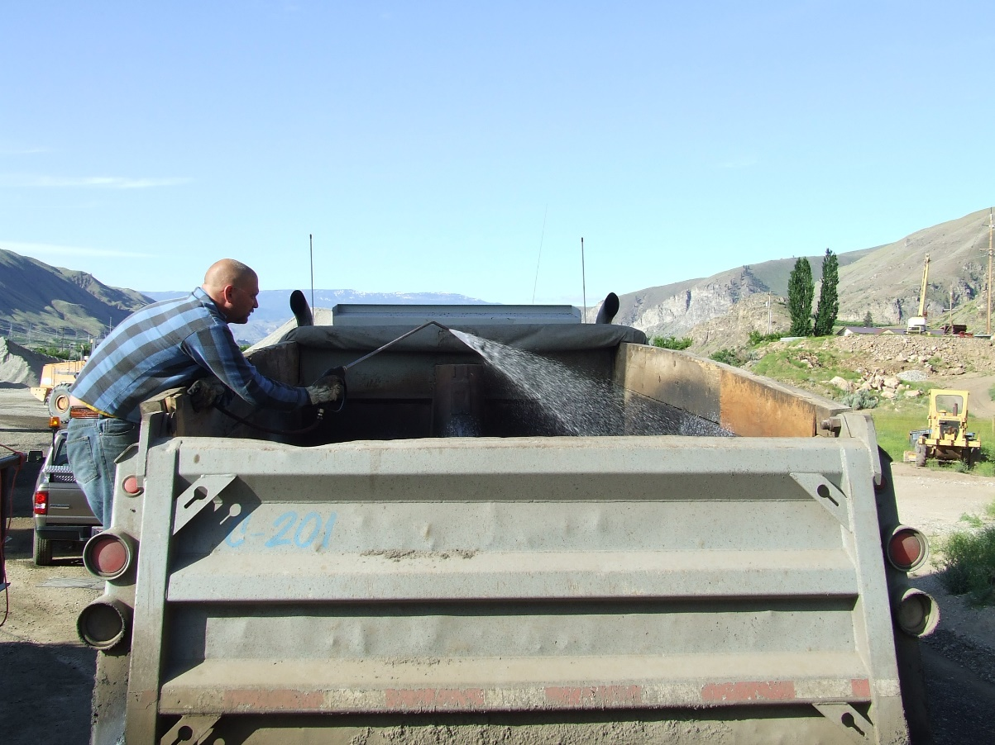
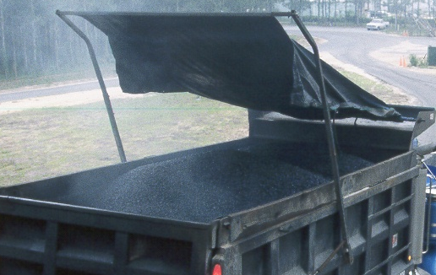
Construction Best Practices
Transportation
Adequate number of trucks for continuous paving
Proper loading from the plant to prevent segregation
Asphalt mix delivered at the proper temperature
Cover truck beds with tarp to prevent mix from cooling
Use of anti-adhesive material from INDOT QPL on truck beds.
DIESEL FUEL

Slide 53
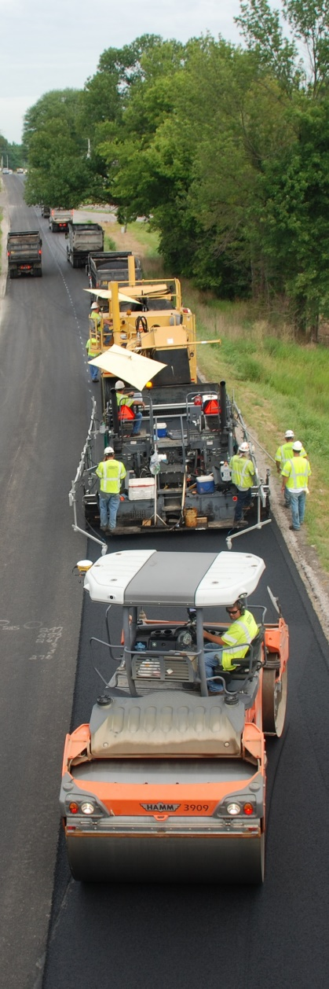
Construction Best Practices
Production
Weather limitations for ambient temperatures based on depth of asphalt course
Appropriate paver speed for balanced operation
  Producing Transporting Paving Compacting
Minimize segregation
Smooth finished mat
Proper compaction is achieved
Finished lift thickness is obtained

Slide 54
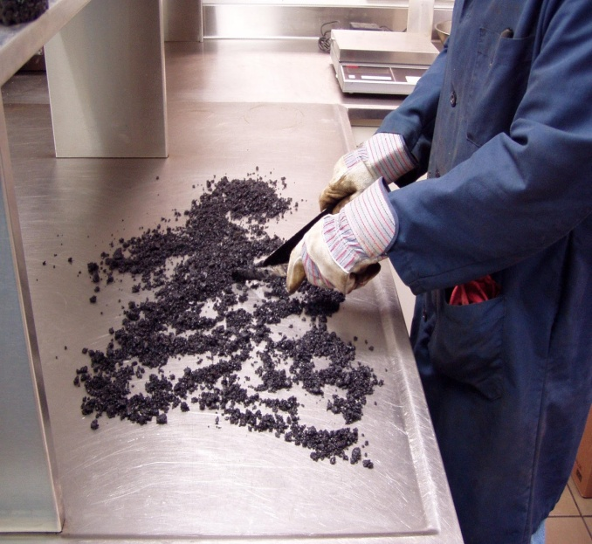
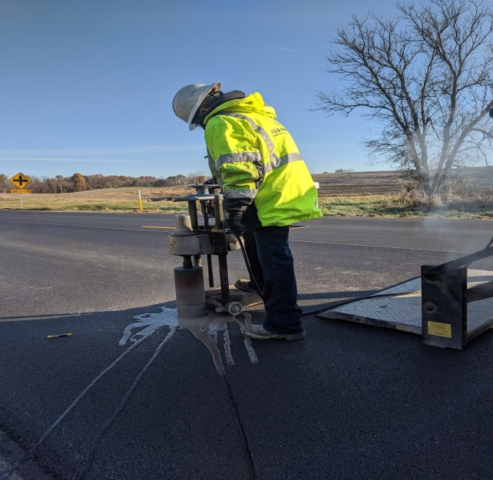
Quality Assurance
Quality Assurance for local agencies
Guidance to follow INDOT Standard Specification section 402
  Type D certification requirements
Require submittal of asphalt mix designs and review
Other QA requirements like density/cores?
Inform and train field inspectors. Daily checklist?
Communicate with Contractor before, during, and after production

Slide 55
APAI Online Resources
Liquid Asphalt Binder Changes Resources on APAI’s website
Local Agency Resources on APAI’s website

Slide 56


Visit APAI’s website for resource documents and more information!
Questions? Contact Elizabeth Pastuszka with APAI
epastuszka@asphaltindiana.org
317.586.7280

